Slide 1
Making this resource work for you
Prior to teaching this lesson, please refer to the ‘Unit Overview and Planning Document’.
Further guidance on planning Science Mastery lessons can be found in the detailed planning guidance document.
Refer to the ‘notes’ section on each slide for useful information, including suggested expositions, pedagogical content knowledge, suggested questions, answers and more. Consider using presenter mode so you can see this guidance throughout the lesson.
The introduction slides can be adapted to suit your teaching style and the needs of your class.
Before the lesson, adapt the fix-it slide to address any misconceptions identified in the previous lesson’s exit ticket.
Choose from the suggested activities to suit your class. The intention is not that you complete all of these, but that you select those which ones are most appropriate for your students. It may be appropriate to further adapt activities for your students.
These lessons are designed to occupy approximately 1 hour. To adapt for a shorter or longer lesson duration we advise you to adapt the activity section accordingly.
Please consider using the final slide to send feedback about this lesson or examples of PowerPoints that you have adapted to our design team. Your feedback is used to improve Science Mastery for all of our teachers and students. We appreciate all suggestions and comments.
Thank you for reading!
The Science Mastery Team

Slide 2
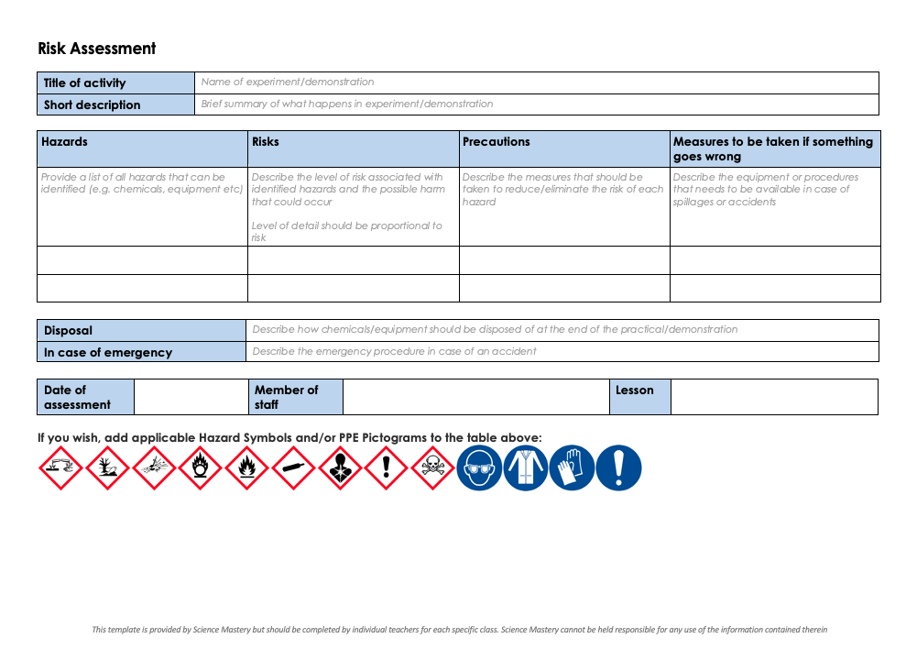
Practical Activity
This lesson contains a practical activity (either a whole class activity or a demonstration)
A risk assessment must be completed for this practical
The template risk assessment can be found here.
The risk assessment should be specific to the class involved and written only by the teaching member of staff
The risk assessment should refer to the current CLEAPSS Hazcards for all chemicals used in the practical for safety and disposal notes.
A list of chemicals used can be found in the Practical Guide
It is good practice for students to wear safety spectacles during all class practicals and demonstrations
Thank you for reading!
The Science Mastery Team

Slide 3

Required Practical: Electrolysis of Aqueous Solutions
Answer the questions below.
What is used to measure current in a circuit?
State the ions that water produces in a solution.
Describe the test for hydrogen gas.
Sodium chloride solution contains two types of positive ions, hydrogen ions (H+) and sodium ions (Na+). Why is hydrogen produced at the negative electrode and not sodium?
Balance the half equation H⁺ + e⁻ → H₂
An ammeter is used to measure current.
Water produces hydrogen (H⁺) and hydroxide (OH⁻) ions
If a lit splint in placed in hydrogen gas, a squeaky pop is heard.
Sodium is more reactive than hydrogen, so therefore hydrogen is produced at the cathode.
2H⁺ + 2e⁻ → H₂
Notes:
Big idea: Reactions Rearrange Matter
Foundation: State the ions in molten sodium chloride
Stretch: State the ions in sodium chloride solution.
Answers:
Foundation: Na⁺ and Cl⁻
Stretch: H⁺ OH⁻ Na⁺ and Cl⁻

Slide 4
Required Practical: Electrolysis of Aqueous Solutions
Do Now:
What is used to measure current in a circuit?
State the ions that water produces in a solution.
Describe the test for hydrogen gas.
Sodium chloride solution contains two types of positive ions, hydrogen ions (H+) and sodium ions (Na+). Why is hydrogen produced at the negative electrode and not sodium?
Balance the half equation H⁺ + e⁻ → H₂
Drill:
State the ions in molten sodium chloride
State the ions in sodium chloride solution.
Deduce which ions would be discharged at each electrode in the electrolysis of sodium chloride solution.
Notes:
Answers:
Do Now:
1. An ammeter is used to measure current.
2. Water produces hydrogen (H⁺) and hydroxide (OH⁻) ions
3. If a lit splint in placed in hydrogen gas, a squeaky pop is heard.
4. Sodium is more reactive than hydrogen, so therefore hydrogen is produced at the cathode.
5. 2H⁺ + 2e⁻ → H₂
Drill:
1. Na⁺ and Cl⁻
2. H⁺ OH⁻ Na⁺ and Cl⁻
3. H⁺ and Cl⁻

Slide 5
Required Practical: Electrolysis of Aqueous Solutions
Read Now:
If you can quench your thirst by walking to the kitchen for a glass of water, then you are one of the lucky ones. Almost 2 billion people worldwide do not have easy access to drinking water, according to the World Health Organisation (WHO). Half of the world’s population could be living in areas that are facing water scarcity by 2025, according to UNICEF. Scientists are busy thinking of solutions. One option is to take salty water from the ocean and make it drinkable using a process called desalination. Desalination requires a lot of energy, but it may be possible to power the process using solar energy. Other solutions include capturing water from the air or from the sea, and there are even technologies that can produce potable water from human faeces!
How many people worldwide do not have easy access to drinking water?
What proportion of the world’s population are facing water scarcity by 2025?
Define the words in bold.
Describe one possible solution to bring clean drinking water to more people worldwide.
Notes:
Answers:
1. Almost 2 billion people worldwide do not have easy access to drinking water.
2. Half of the world’s population could be facing water scarcity by 2025
3. Scarcity = a lack of, not having enough of, hard to find. Potable water = drinkable water (from Y9)
4. One solution that might bring clean drinking water to more people is desalination – the process of removing salt from water. Other solutions include capturing water from the air or sea or human faeces.

Slide 6

C4.2.11 C4.2.12
03/02/2025
Required Practical: Electrolysis of Aqueous Solutions
C4.2.1 PKR: Reactivity of Metals
C4.2.2 Extracting Less Reactive Metals
C4.2.3 PKR: Ions, Ionic Bonding and Deducing Ionic Formulae
C4.2.4 (HT) Ionic Equations and Displacement Reactions
C4.2.5 (HT) Writing Half Equations
C4.2.6 (HT) Ionic Equations for the Reactions of Acids and Metals
C4.2.7 Introduction to Electrolysis
C4.2.8 Extracting Metals by Electrolysis
C4.2.9 Electrolysis of Molten Ionic Compounds
C4.2.10 Electrolysis in Solutions
C4.2.11 RP: Electrolysis of Aqueous Solutions 1
C4.1.12 RP: Electrolysis of Aqueous Solutions 2
C4.1.13 TIF: Corrosion and its Prevention
C4.2.14 (HT) Obtaining Raw Materials
C4.2.15 Recycling Metals
C4.2.16 Feedback Lesson
Notes:
Big Idea: Reactions Rearrange Matter
Suggested Hook:
Ask students to how they think the products of electrolysis would be different for sodium chloride solution vs molten sodium chloride

Slide 7

Following this lesson, students will be able to:
Describe the apparatus used for electrolysis
Safely carry out the electrolysis of a salt solution
Predict the products of electrolysis of a salt solution
Test for gases produced in electrolysis
Key Words:
electrolysis
salt solution
short circuit
inert
Notes:
Guidance:
See unit overview document and planning guidance to see how these objectives are typically assessed at GCSE, including examples of what students should be able to do following this lesson.
Planning for different needs:
The learning objectives given on this slide are suggested based on the most common requirements for exams, however they can be adapted based on the needs of different classes.
For best practice, the unit preparation booklet should be used to determine the appropriate focus of lessons within the unit.
While it is not possible to explicitly split content into levelled grades, we recommend that lesson objectives can be classified as critical, core or stretch.
Critical: the content or skill is essential for all students to be able to progress.
Core: the content or skill is important for students to progress, but other opportunities may be available to revisit it.
Stretch: the content or skill may not be essential for all students but is important for students aiming for the highest grades.
Key skill: this is a crucial skill being developed in this unit as part of the skill mapping
C4.2.11 C4.2.12 Lesson Objectives:
Critical: Describe the apparatus used for electrolysis
Key skill: Safely carry out the electrolysis of a salt solution
Core: Predict the products of electrolysis of a salt solution
Core: Test for gases produced in electrolysis

Slide 8
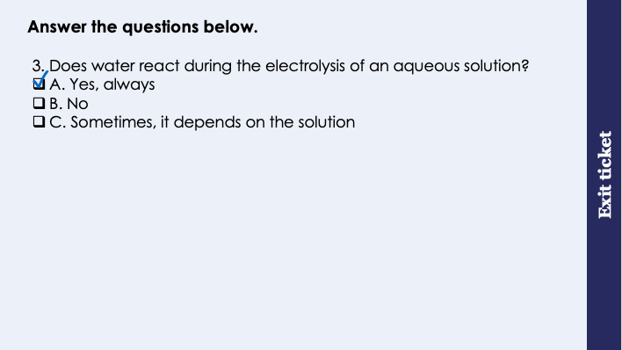
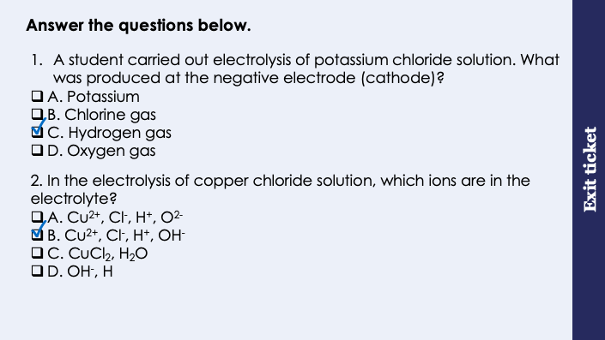
This is the fix-it portion of the lesson
The fix-it is an opportunity to respond to gaps in knowledge, especially those identified by the previous lesson’s exit ticket.
The teacher should customise this slide as needed, to facilitate
reteach, explanation, demonstration or modelling of ideas and concepts that students have not yet grasped or have misunderstood.
practise answering specific questions or of key skills.
redrafting or improving previous work.
Notes:
Fix-it guidance from previous exit ticket:
Q1. Answer: C
If students answer A, they are unable to deduce which positive ion is discharged at the cathode when there is more than one.
If students answer B or D, they do not realise that negative ions are not discharged at the cathode.
To fix-it, annotate a diagram of electrolysis with the different ions present during the electrolysis of an ionic substance in a solution of water. Narrate your thinking process to decide which ions are discharged at each electrode, and then give students different solutions to practice doing the same.
Q2. Answer: B
If students answer A, they have almost chosen the correct ions, however they have demonstrated the misconception the the ions from water are hydrogen and oxide, instead of hydrogen and hydroxide ions.
If students answer C, they have chosen the compounds that make up the electrolyte (water and copper chloride) instead of the ions that these dissociate into, as the question requests.
If students answer D, they have chosen the ions that are left behind after the other ions are used up/discharged at the electrodes. To fix-it, annotate a diagram of electrolysis with the different ions present during the electrolysis of an ionic substance in a solution of water. Show that the electrolyte is the liquid with all ions in before electrolysis occurs.
Q3. Answer: A
If students answer B or C, they do not realise that water always reacts when an aqueous solution is electrolysed. To fix-it, explain that although water is always split up into its ions, that is not the same as these ions are always discharged at the electrodes.

Slide 9
What happens in electrolysis?
Battery or power source
Generates a current to flow through the electrolyte
Anode
Positively charged electrode
-
+
+
Electrolyte
The liquid that contains the ions (current is passed through)
-
-
+
+
Cathode
Negatively charged electrode
-
+
+
-
-
+
-
Notes:
This lesson is intended to cover two hours. The order of activities is
Recap of learning from lesson 7 (Introduction to Electrolysis) and check for understanding of basic electrolysis apparatus
Students to formulate hypothesis for electrolysis of copper (II) chloride based on prior learning
Slow demonstration by the teacher, including highlighting of risks and appropriate precautions
Student practical and simultaneous filling out of practical sheet
Independent practice of Required Practical related questions
Exposition type: Demonstration
For this part of the lesson you will need a visualiser, and the equipment needed for the electrolysis demonstration (see practical guide for this demonstration for more information). You may want to carry out this demonstration with sodium chloride solution, and remind students of all of the the key information about electrolysis as you go, before asking students to do the same with a different solution for their required practical, independently (copper (II) chloride).
Alternatively, you could do a slow demonstration using copper (II) chloride, and ask students to follow along with each step as they carry out the same practical. This is a much more controlled method, suitable for students who need more structure and guidance. These slides can be adapted to suit either approach.
Have a simple electrolysis set up for students to observe. This could consist of a simple beaker, 2 electrodes, crocodile clips and wires and power pack, with the copper (II) chloride solution as electrolyte. To save time, have the group sets of apparatus placed on trays prior to the lesson so that one tray can be placed in front of each group and students simply have to assemble and switch the current on to observe the reaction taking place.
Model teacher exposition:
Today we will be carrying out an electrolysis required practical.
I have an electrolysis demonstration set up here at the front which you will be able to watch on the screen, and I have also put a different electrolysis set up on your desks. Please do not touch these until I ask you to. Later in this unit you will be carrying out your own electrolysis required practicals, so pay close attention to this demonstration.
Firstly, in order for electrolysis to take place, there are a few things that must always be present.
Firstly, a battery or power source. Point out the power source under the visualiser and in the set-ups on the desks.
Why do you think a power source is needed for electrolysis? To produce a current of electricity to pass through the substance.
Next, we have two electrodes, one positively charged (the anode) and one negatively charged (the cathode). Notice how the anode is connected to the positive side of the battery and the cathode is connected to the negative side of the battery.
What do you think the electrodes are for? The electrodes carry the current from the wires into the substance (electrolyte) so that the current can pass through the it.
We can use the pneumonic PANIC to remember which electrode is which (Positive Anode, Negative Is Cathode)
Dual code this pneumonic onto the board for students to use later.
Point out the anode and cathode under the visualiser and in the set-ups on the desks.
Remember, electricity is the flow of electrons or ions. In electrolysis, we have a circuit, but part of that circuit is made of the electrolyte. Trace the path of electricity around the circuit with your finger.
Finally, and most importantly, for electrolysis to happen we must have an electrolyte. This is a liquid that contains ions. This is the substance which will be split up when the current passes through it.
Why do you think that the electrolyte must be a liquid? (Clue: Think back to the reason why ionic substances cannot conduct electricity when solid, from C4.2) Electrolysis cannot be carried out with solid substances, because the ions in the substance need to be free to move.
That is why electrolytes will always be molten (melted) substances or substances dissolved in a solvent, like water.
Point out the electrolyte under the visualiser and in the set-ups on the desks.
The electrolyte we will use for your electrolysis required practical is copper (II) chloride. Dual code the formula for this on the board (CuCl₂)
Now we are going to switch on the power and observe what happens. Look at the animation on the screen. What happens to the ions when the current is switched on? They move to the electrodes.
The positive ions (cations) move to the negative electrode (cathode). Here, they gain electrons to become neutral. We say that the ions are discharged.
What is another word for the gain of electrons? Reduction (remember OIL RIG – Oxidation Is Loss of electrons, Reduction Is Gain of electrons)
The negative ions (anions) move to the positive electrode (anode). Here, they lose electrons to become neutral. We say that the ions are discharged
What is another word for the loss of electrons? Oxidation (remember OIL RIG)
Looking at the electrolysis set up. Your electrolyte is sodium chloride. We can see bubbles at the anode. Based on what we have just discussed, what do you think these bubbles are? chlorine
Without inhaling up close, you should be able to smell the chlorine (it’s like a swimming pool smell!)

Slide 10
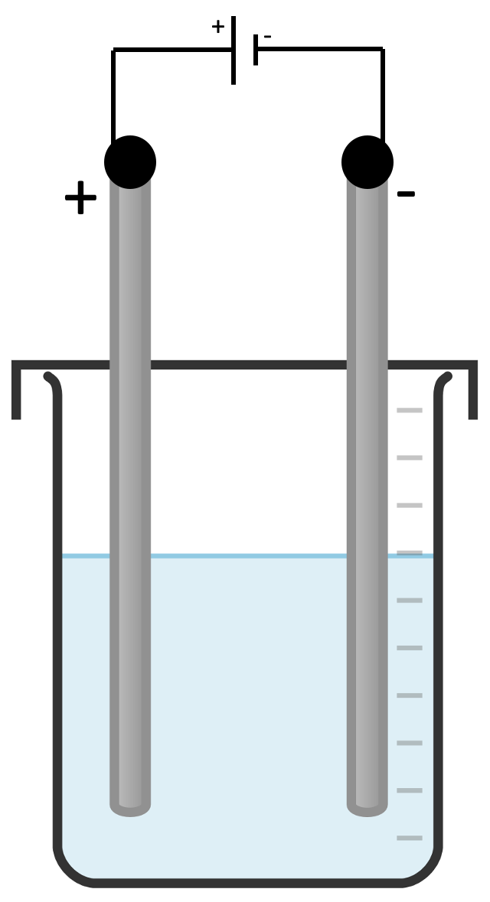
Can you correctly label the electrolysis diagram?
= positively charged ions
= negatively charged ions
cell/battery
cathode
beaker
anode
an inert material
electrolyte
Stretch: the flow of electrons when the circuit is switched on
cation
anion
Notes:
This slide is a recap of learning from lesson 7 (Introduction to Electrolysis) and can be used to support the student worksheet question 1 which students will complete prior to beginning the practical.
Use this diagram to check that students can identify all parts of an electrolysis apparatus. Included in the folder is blank diagrams to label if required.
Why do we use graphite for electrodes?
Graphite is inert – this means it will not react with the electrolyte or products of electrolysis
Graphite conducts electricity (link back to C4.1 – students should be able to explain why graphite conducts electricity as a giant covalent substance)

Slide 11
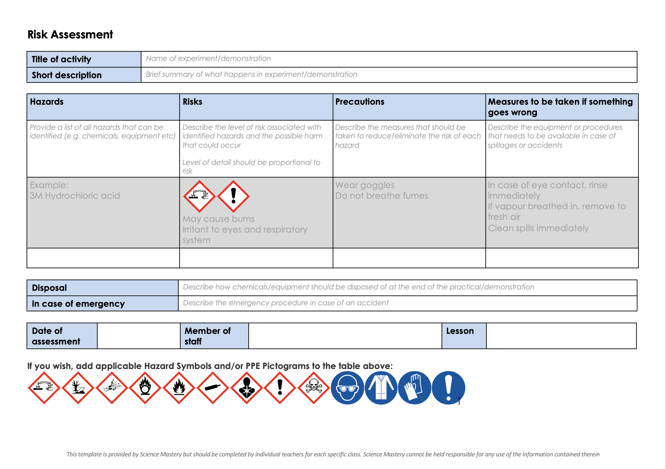
Risk Assessment
A risk assessment must be completed for this practical
The template risk assessment can be found here.

Slide 12
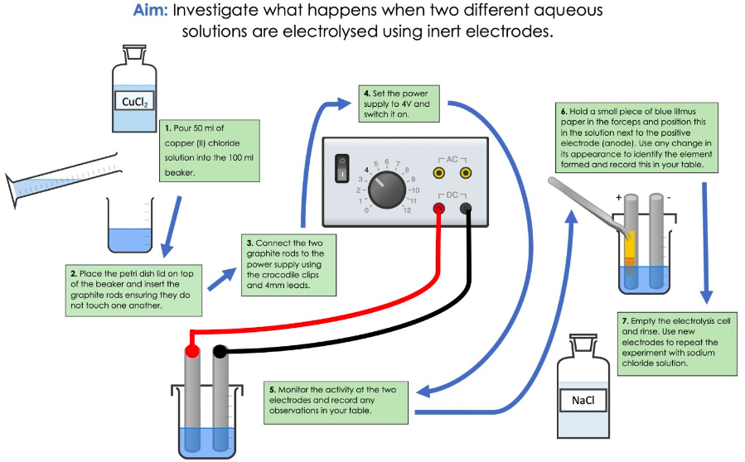
Notes:
Exposition type: Demonstration/Practical
See the video in the lesson folder which shows an experienced teacher delivering this required practical.
Model teacher exposition:
You are going to carry out the electrolysis of copper chloride solution.
Firstly, you are going to write down a hypothesis for this investigation. What do you think will be formed at the anode and the cathode? Explain your hypothesis, using scientific ideas from previous lessons.
Give students time to note down their hypothesis in writing, and to explain their reasoning.
At this point the teacher should demonstrate the practical carefully, referring to the steps on the board.
Be explicit about safety considerations, noting that the electrodes do not touch each other as this would cause a short circuit that might damage the apparatus, and that chlorine is a toxic gas that should not be directly inhaled. Ensure that a thorough risk assessment has been completed in advance of this demonstration/class practical.
You may decide to lead students through the practical:
Carry out 1 step,
wait for all student groups to carry out the same step
Carry out next step
wait for all student groups to carry out that step
..and so on
Doing the practical in this way maintains maximum control over student activities, and allows you to explain each step, and the key information that goes alongside, instead of having to explain everything at the start before students see the practical.
You can repeat with sodium chloride solution, so that this is also an opportunity to collect samples of gases. The gas tests can be caried out by the teacher after the practical to prove that the gases are in fact as predicted.

Slide 13
Analysing the products of electrolysis
We can use gas tests to identify the gases produced in electrolysis
Gas to test | Method | Positive result
Oxygen
Hydrogen
Chlorine
Place a glowing splint into the gas
The splint will relight
Place a lit splint into the gas
It will make a squeaky pop sound
Place damp blue litmus paper in a test tube of the gas
The litmus paper is bleached

Slide 14

A student makes a hypothesis:
"When different salt solutions are electrolysed with inert electrodes, the product at the negative electrode is always a metal.”
Discuss with your partner how you would test this hypothesis in the laboratory. You should: •think about how you would set up the apparatus • give the independent variable •describe what you would see at the negative electrode if the hypothesis is true. • Suggest one safety precaution that should be taken during this investigation.

Slide 15
Drill
Define electrolysis.
What is an electrolyte?
What is the positive electrode called?
What is the negative electrode called?
Why does an electrolyte have to be a liquid?
What electrode does a cation move towards?
What electrode does an anion move towards?
At which electrode does oxidation take place?
At which electrode does reduction take place?
(HT only) Write a half equation to show what happens when chloride ions are discharged at the anode.
Notes:
Purpose: This is a knowledge drill. The purpose of this is to check that the critical knowledge is secure before pupils move onto independent practice.
Suggested guidance: There are a range of ways this could be done depending on time and ability range of the class:
Mini whiteboards
As full sentences in exercise books
As short answers in exercise books
In the pupil workbook
As pair talk
As cold call

Slide 16
Drill answers
Electrolysis is the process of passing an electric current through a substance, to break it down into its ions.
An electrolyte is a liquid that contains ions.
The positive electrode is called the anode
The negative electrode is called the cathode
An electrolyte has to be a liquid so that the ions are free to move.
A cation (+) moves towards the cathode (-)
An anion (-) moves towards the anode (+)
Oxidation takes place at the anode
Reduction takes places at the cathode
2Cl⁻ → Cl₂ + 2e⁻
Notes:
Purpose: This is a knowledge drill. The purpose of this is to check that the critical knowledge is secure before pupils move onto independent practice.
Suggested guidance: There are a range of ways this could be done depending on time and ability range of the class:
Mini whiteboards
As full sentences in exercise books
As short answers in exercise books
In the pupil workbook
As pair talk
As cold call

Slide 17
I: Testing a hypothesis with electrolysis
A student had a hypothesis ‘The electrolysis of a salt solution produces a metal at the negative electrode and a gas at the positive electrode’
(a) What observation would a student make if a gas is produced at the positive electrode?
Bubbles/fizzing/effervescence at the positive electrode
(b) What observation would a student make if a metal is produced at the negative electrode?
A solid produced at the negative electrode
(c) The table below shows the students results. Which salt solution in the table above does not match the student’s hypothesis?
Salt solution | Product at the negative electrode | Product at the positive electrode
Copper chloride | copper | chlorine
Sodium fluoride | hydrogen | fluorine
Potassium nitrate | Hydrogen | oxygen
Salt solution:
Reason:
Potassium nitrate or sodium fluoride
Hydrogen is not a metal
Notes:
Teacher guidance
For (a) ignore ‘gas produced’
For (b) allow the electrode changes colour. Ignore metal is produced
For (c) allow hydrogen is a gas, hydrogen is not a solid, the products at both electrodes are gases, the product at the negative electrode is not sodium/potassium or potassium is more reactive than hydrogen.
Purpose: The I-We-You section aims to support pupils to build skills that they most commonly need when answering questions associated with this knowledge in the assessment. This section is also used to interleave other content we expect pupils to know at this stage of their education in order that they build a big picture of the science they are learning.
For the ‘I’ activity, the teacher should model how to answer the question. They can do this by narrating their thinking process aloud, and making links to learning earlier in the lesson explicit.
For the ‘we’ activity, the teacher and students work though a similar example together, in order to prepare students to be able to answer a similar question independently.
Opportunities for the ‘you’ activity – independent practise – occur in the activity portion of the lesson once the student is secure enough to process independently.

Slide 18
We: Testing a hypothesis with electrolysis
A student had a hypothesis ‘The electrolysis of sodium chloride solution produces a sodium metal at the negative electrode and chlorine gas at the positive electrode’
(a) What observation would a student make if chlorine gas was produced at the positive electrode?
Bubbles/fizzing/effervescence
(b) What observation would a student make if sodium was produced at the negative electrode?
A solid produced at the negative electrode
(c) When the student carried out the electrolysis experiment, she observed bubbles at both electrodes. Explain this observation.
Chlorine gas was observed forming at the positive electrode (as the hypothesis predicted). However, at the negative electrode hydrogen gas was produced, not sodium. This is because hydrogen is less reactive than sodium, and so hydrogen ions are discharged instead of sodium ions.
Notes:
Teacher guidance
For (a) ignore ‘gas produced’
For (b) allow the electrode changes colour. Ignore metal is produced
Purpose: The I-We-You section aims to support pupils to build skills that they most commonly need when answering questions associated with this knowledge in the assessment. This section is also used to interleave other content we expect pupils to know at this stage of their education in order that they build a big picture of the science they are learning.
For the ‘I’ activity, the teacher should model how to answer the question. They can do this by narrating their thinking process aloud, and making links to learning earlier in the lesson explicit.
For the ‘we’ activity, the teacher and students work though a similar example together, in order to prepare students to be able to answer a similar question independently.
Opportunities for the ‘you’ activity – independent practise – occur in the activity portion of the lesson once the student is secure enough to process independently.

Slide 19
You: Testing a hypothesis with electrolysis
A scientist had a hypothesis ‘The electrolysis of magnesium chloride produces magnesium at the negative electrode and chlorine at the positive electrode’
What observation would a scientist make if chlorine is produced at the positive electrode?
Bubbles/fizzing/effervescence at the positive electrode
(b) What observation would a scientist make if magnesium is produced at the negative electrode?
A solid produced at the negative electrode
(c) Complete the table to suggest whether the hypothesis is correct or incorrect.
Hypothesis about what will happen at the anode | Correct or Incorrect?
Hypothesis about what will happen at the cathode | Correct or Incorrect?
Correct
Correct
Notes:
Teacher guidance
For (a) ignore ‘gas produced’
For (b) allow the electrode changes colour. Ignore metal is produced
For (c) allow hydrogen is a gas, hydrogen is not a solid, the products at both electrodes are gases, the product at the negative electrode is not sodium/potassium or potassium is more reactive than hydrogen.
Purpose: The I-We-You section aims to support pupils to build skills that they most commonly need when answering questions associated with this knowledge in the assessment. This section is also used to interleave other content we expect pupils to know at this stage of their education in order that they build a big picture of the science they are learning.
For the ‘I’ activity, the teacher should model how to answer the question. They can do this by narrating their thinking process aloud, and making links to learning earlier in the lesson explicit.
For the ‘we’ activity, the teacher and students work though a similar example together, in order to prepare students to be able to answer a similar question independently.
Opportunities for the ‘you’ activity – independent practise – occur in the activity portion of the lesson once the student is secure enough to process independently.

Slide 20
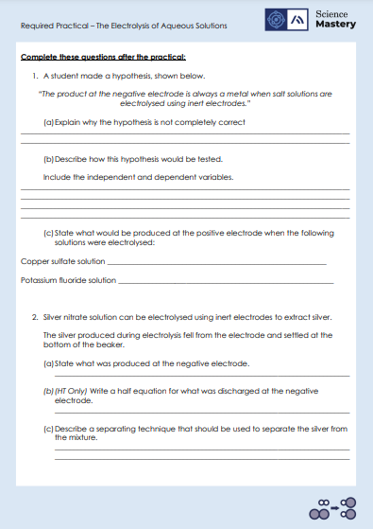
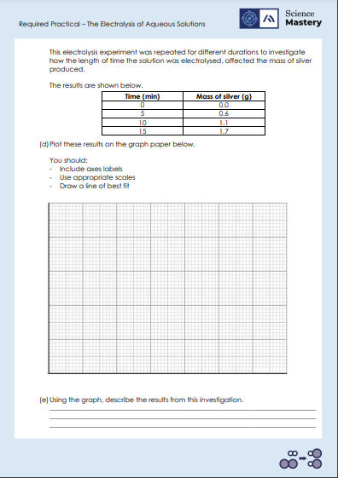
Activity – After the Practical Worksheet Questions

Slide 21
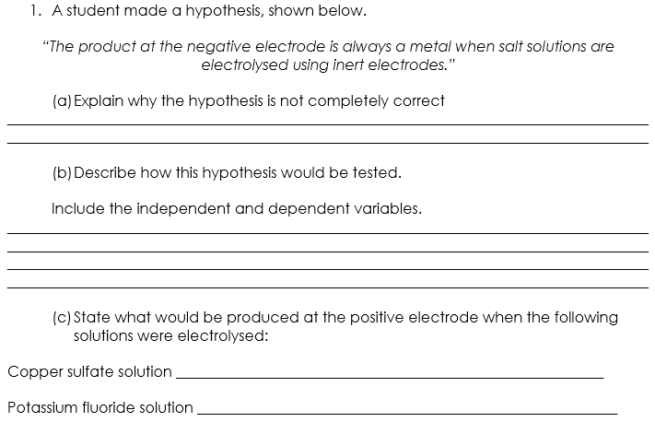
Answers
If the metal is more reactive than hydrogen, then hydrogen gas is produced instead of the metal
IV – different salt solutions
DV – observing metal forming on the negative electrode
Set up electrolysis by placing salt solution in a beaker and inserting inert electrodes that are connected to a power supply.
Oxygen
Fluorine

Slide 22
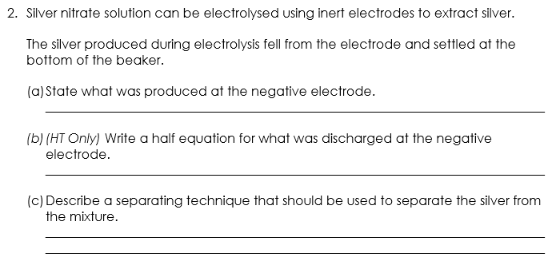
Answers
Silver
Ag⁺ + e⁻ → Ag
Filtration should be used. To filter the mixture to separate the silver, the mixture should be passed through filter paper that has been placed in a funnel. The residue left in the filter paper is silver.

Slide 23

Answers
(e) The longer the solution is electrolysed, the greater the mass of silver product is made.
2.0
1.5
1.0
0.5
0
X
Mass of Silver (g)
X
X
X
0 5 10 15
Time (min)

Slide 24
Answer the questions below.
Which answer is not a reason that graphite is used for electrodes?
A. Graphite is an inert material
B. Graphite is a simple covalent substance
C. Graphite is a good conductor of electricity
✓
2. What will a student observe at the negative electrode when carrying out the electrolysis of sodium chloride?
A. A solid will form (sodium metal)
B. A gas will form (chlorine gas)
C. A gas will form (hydrogen gas)
✓
3. A gas is collected at the negative electrode. When a lit splint is placed in the gas, a squeaky pop sound is heard. What is the gas?
A. Hydrogen
B. Oxygen
C. Chlorine
✓
Notes:
Q1. Answer: B
If students answer A or C, they are unable to explain why graphite is a suitable material to use for electrodes. To fix-it, reiterate the advantages of using graphite in electrolysis with reference to these properties.
Q2. Answer: C
If students answer A, they have recognised that sodium usually forms at the negative electrode, however they have not realised that in this example hydrogen would be formed instead. To fix-it, explain to students how to determine the ion discharged where there is more than one positive ion in a solution. Give students some example solutions to practice identifying the discharged ion.
If students answer B, they have correctly identified the substance that would form at the positive electrode, not the negative electrode. To fix-it, explain to students how to determine the ion discharged at each electrode. Give students some example solutions to practice identifying the ion discharged at the anode and cathode.
Q3. Answer: A
If students answer B or C, they are unable to identify gases using the gas tests. To fix-it, demonstrate the gas tests and ask students to complete a table that summarises each.

Slide 25
Lesson C4.2.11 C4.2.12
What was good about this lesson? | What can we do to improve this lesson?
Send us your feedback by clicking this link
or by emailing sciencemastery@arkonline.org
Thank you!

